Slide 1

Outland Adventures
Katherine Graham

Slide 2

Introduction
Blythe Timmerson and Jim Ford opened Outland Adventures to plan trips, lead trips, and rent and sell inventory.
Purpose: To create a database for outland adventures to store and manage customer, trip, booking, employee, inventory data.

Slide 3
Tables
Employee
Customer
Inventory Item
Transaction
TransactionXInventoryItem
Experience
Trip
TripXEmployee
Booking
Region

Slide 4
Business Rules
Customers can have zero or many bookings
Each booking is associated with exactly one customer.
A trip can have one or many bookings
Each booking is exactly one trip
An experience may have one or many trips
Each trip is exactly one experience
A trip can have one or many guides
Each transaction is exactly one customer
A customer can have 0 or many transactions
Each transaction contains one or many items
Each transaction line is exactly on inventory item and is classified as a rental or a purchase
Each trip occurs in only one region
A region can have zero or many trips

Slide 5
Assumptions
Employees can only have only one role in the company
Each trip can occur only in one region
Only employees with role of “guide” can go on trips
Customers purchase and rent from the store’s inventory
Each Inventory Item is one piece of equipment with an acquisition date
Customers can purchase or rent equipment outside of bookings
If an employee rents or purchases a piece of equipment, they must exist in the customer table
Sold Items are marked as SOLD and are not available for further transactions
Each customer on a trip needs a booking line

Slide 6
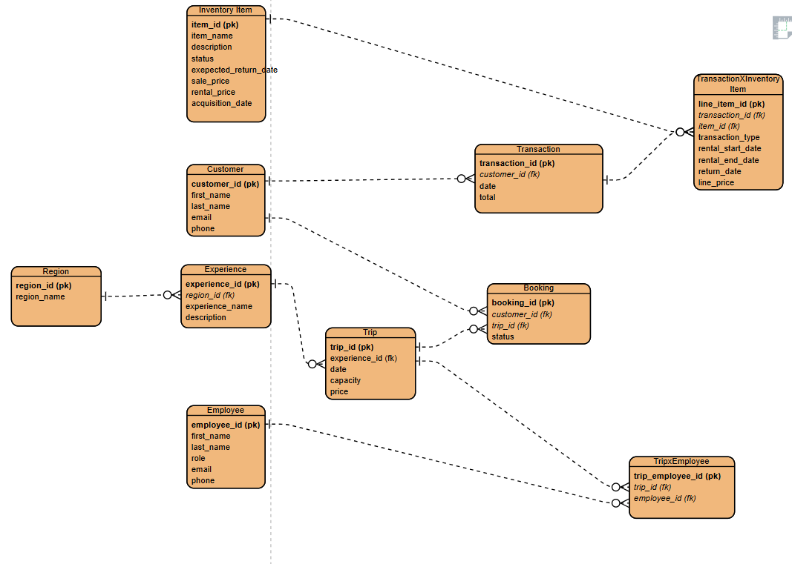
ERD

Slide 7
Report Needs
Are there inventory items that are over five years old?
Is there any one of those locations that has a downward trend in bookings?
Do enough customers buy equipment to keep equipment sales?

Slide 8
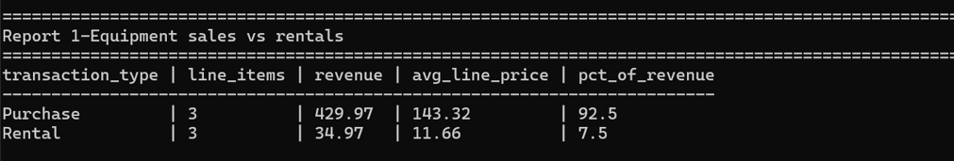
Report 1: Equipment sales vs rentals

Slide 9

Report 2: Booking trend by region

Slide 10

Report 3: Inventory older than 5 years

